Slide 1
Amazon Product Data analysis and Classification
Presenter
Praneetha G

Slide 2
Agenda
Introduction
Dataset Overview
Workflow
Web scraping and Data Collection
Data Cleaning and Preprocessing
Data Analysis and Visualization
Relational Database Storage and management
Unsupervised Learning
Supervised Learning
Sample Output

Slide 3
Introduction
The project focuses on extracting, cleaning, classifying, storing, and analyzing Amazon product data to improve categorization and gain insights.
It utilizes Machine Learning (ML), NLP, and SQLAlchemy to streamline e-commerce data processing.

Slide 4
Dataset Overview
Product Name – Title of the listed product.
Category – Product classification such as beauty and personal care, Clothing and accessories, Electronics and Computers and Home decors.
Price – Cost of the product in the marketplace.
Rating – Average customer rating based on reviews.
Number of Reviews – Count of customer feedback.

Slide 5
Work Flow
Web Scraping and Data Collection
Data Cleaning and Preprocessing
Relational Database Storage and management
Unsupervised Learning
Supervised Learning
Data Analysis and Visualization

Slide 6
Web Scraping and Data Collection
Project extracts Amazon product data using Selenium & BeautifulSoup, storing it in a structured format for further analysis.
Process Workflow:
→ Initialize Selenium – Automate browsing to fetch product pages.
→ Extract HTML Content – Parse product details (Title, Price, Ratings, Reviews, Category).

Slide 7
Data Cleaning and Preprocessing
Handling Missing Values
Duplicate Removal
Text
Preprocess
Data Types Conversion
Created of New column
Data Cleaning and Standardization

Slide 8
Data Analysis and Visualization
An analysis is performed to uncover trends, category distributions, pricing patterns, and customer sentiment insights using statistical methods and visualizations
→ Product distribution
→ Price trends
→ Rating patterns

Slide 9
Relational Database Storage and management
A relational database was set up using SQLite & SQLAlchemy
Designed schema for structured storage
Ensured data integrity
Enabled easy retrieval for analysis

Slide 10
Unsupervised Learning
DBSCAN – Grouped products based on Price & Rating, tuning parameters to detect anomalies (noise points -1).
K-Means – Used the Elbow Method to find the optimal number of clusters for better segmentation.
Hierarchical Clustering – Applied Agglomerative Clustering and dendrograms for meaningful groupings.
Evaluation – Measured silhouette score & noise ratio to ensure well-separated clusters and detect anomalies.

Slide 11
supervised Learning
Product Category Classification
Trained a model to classify products into categories based on product name. Used Logistic Regression, Naive bayes Decision Trees, and Random Forest for classification.
Model Used – Applied Naive Bayes for product classification.
Evaluation Metrics – Used accuracy score & classification report to assess model performance.

Slide 12
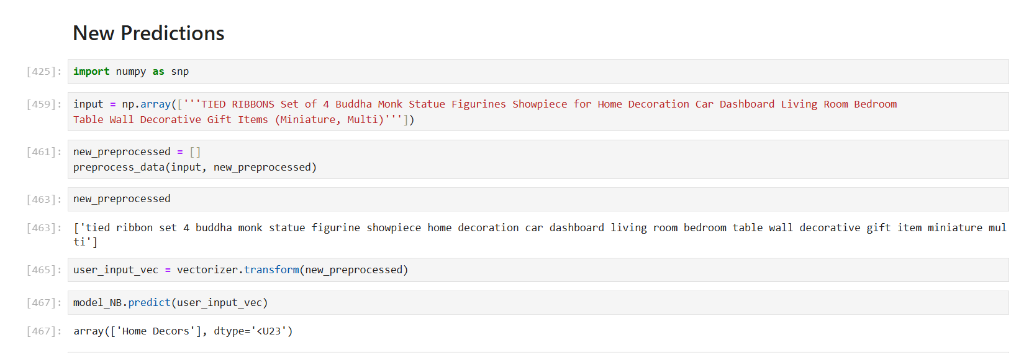
Sample Output

Slide 13
THANK YOU

